Slide 1
WELCOME Working together to cover what’s important in life.
Notes:
Hello, my name is Cynthia De La Pena and I represent Community First Health Plans, where we’re keeping our commitment to you. Community First is your HMO benefit plan option in the San Antonio area for Plan Year 2021.

Slide 2
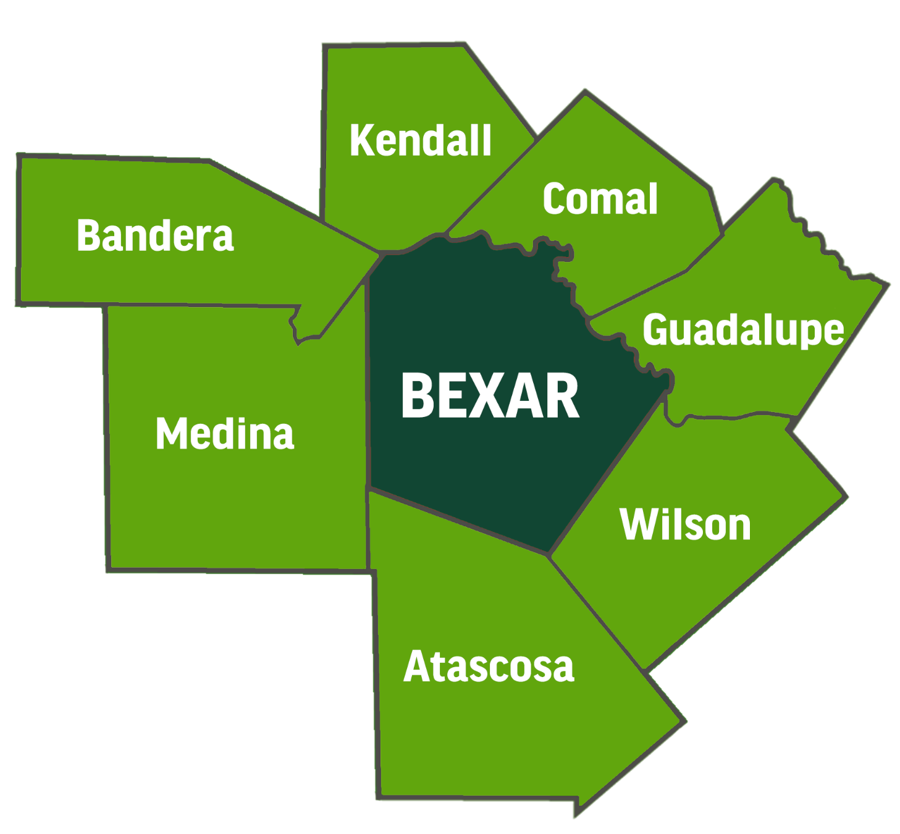
Community First Health Plans is a locally owned and managed, non-profit HMO, serving the following counties:
Notes:
We are a locally owned and managed non-profit HMO, and our service area covers Bexar and the surrounding counties. This includes Atascosa, Bandera, Comal, Guadalupe, Kendall, Medina, and Wilson counties. If you live or work in one of these counties in our service area, you are eligible to select Community First for your health benefit plan.

Slide 3
Customer Service is the Core of Our Business
Our staff, including the Member Services Department, are located in San Antonio, providing you with easy access to customer assistance.
Notes:
All Community First employees are located in one of our three San Antonio offices. There are no out-of-state call centers or corporate headquarters. Because our staff is based in the community we serve, we are easily accessible to our members.

Slide 4
Your Community First Network
The Provider Network Includes:
23 Hospitals
More than 550 Primary Care Physicians (PCPs)
More than 1,700 Specialists
27 Urgent Care Clinics
Notes:
The Community First network includes providers in our eight-county service area. There are 23 hospitals, more than 550 PCPs, more than 1,700 specialists, and 27 Urgent Care Clinics. The network is subject to change so always check the Community First website for the most up-to-date information or call Member Services at (210) 358-6262 if you’d like to find out if a particular provider is in the network.

Slide 5
We’re Here to Help
Dedicated Customer Service Lines
(210) 358-6262, Toll-free (877) 698-7032
TTY: (210) 358-6080, Toll-free (800) 390-1175
Monday – Friday, 8:30 a.m. – 5 p.m. CT
After-hours phone calls are routed to the CFHP Nurse Advice Line
Notes:
We have dedicated customer service lines, both local and toll-free, for our members to call whenever they have questions. Our Member Services staff specialize in the GBP health benefit plan and are available to take calls from members Monday through Friday from 8:30 a.m. to 5 p.m. CT. After hours calls are routed to our Nurse Advice Line, so members can reach us anytime.

Slide 6
Benefits Overview
Physicians/Lab Services
*PCP office visit $25
*Specialist office visit $40
*Diagnostic x-rays, mammography, lab Tests 20% (unless provided during an office visit)
$2,000 out-of-pocket coinsurance max per person per plan year (applies to all services)
No maximum on out-of-pocket copayments
*Immunizations: no charge
High tech radiology (CT scans, MRI, and nuclear medicine) $100 copay plus 20%
Under the Affordable Care Act, certain preventive services are paid at 100% (i.e., at no cost to the member) dependent upon physician billing and diagnosis. In some cases, you will be responsible for payment of some services.
Notes:
Here is a quick overview of the benefit plan. The copayment for a PCP Office Visit is $25. The Specialist Office Visit copayment is $40. The charge for outpatient diagnostic X-rays, Mammography and Lab Tests is 20% coinsurance. A $2,000 out-of-pocket coinsurance max per person per plan year applies to all services. There is no charge for immunizations; however, a $25 copayment will apply if the immunization is provided during a regular office visit. The charge for High Tech Radiology such as CT scans, MRIs, and nuclear medicine is a $100 copayment plus 20% coinsurance.

Slide 7
Benefits Overview (cont’d)
Hospital Services
Inpatient Hospital
$150 per day copayment per admission, (5 day copayment max) plus 20%
$2,250 hospital copayment max per person per plan year
Outpatient Day Surgery
$100 copayment plus 20%
Urgent Care
$50 copayment plus 20%
Emergency Care
$150 copayment plus 20%
Notes:
Inpatient hospital stays are covered with a copayment of $150 per day for up to five days. This does not mean patients are limited to five days in the hospital! What this means is they will only be responsible for copayments for the first five days of their hospital stay. This adds up to $750 in copayments if a member’s hospital stay lasts five days or longer. Each hospital stay also incurs a 20% coinsurance in addition to the copayments.
For inpatient hospital services, there are some limits to the cost sharing members will be responsible for during the plan year. The hospital copayment maximum is $2,250 per person per plan year, which means that once a member’s hospital copayments reach $2,250, he or she is no longer responsible for making any other inpatient hospital copayments for the rest of the plan year.
Similarly, the out-of-pocket coinsurance maximum is $2,000 per person per year. Once a member has paid a total of $2,000 in 20% coinsurance payments for all services including hospital and lab tests, he or she will no longer be responsible for any further coinsurance payments for the rest of the plan year.
The charge for outpatient day surgery is a $100 copayment plus 20% coinsurance. The charge for urgent care visits is $50 plus 20% coinsurance. Emergency room visits are covered with a $150 copayment plus 20% coinsurance.

Slide 8
Benefits Overview (cont’d)
 | Non-maintenance Medication (30-day supply) | Maintenance Medication (30-day supply) | New Retail Pharmacy or Mail Order (90-day supply)
Deductible (plan year) | $50
Tier I | $10 | $10 | $30
Tier II | $35 | $45 | $105
Tier III | $60 | $75 | $180
Notes:
Your health benefit plan includes a three-tier prescription drug benefit.
The copayments for a 30-day supply of non-maintenance medications are $10 for Tier I, generally generic drugs; $35 for Tier II, generally preferred brand-name drugs; and $60 for Tier III, generally non-preferred brand-name drugs. Non-maintenance medications are those that are not taken on a regular basis.
The copayments for a 30-day supply of maintenance medications are $10 for Tier I, generally generic drugs; $45 for Tier II, generally preferred brand-name drugs; and $75 for Tier III, generally non-preferred brand-name drugs. Maintenance medications are those that are taken on a regular basis and refilled regularly to treat an ongoing or chronic condition.
The copayments for 90-day supply of a maintenance medication at a participating retail pharmacy or through mail order are $30 copay for tier 1 drugs, $105 for tier 2 drugs, and $180 for tier 3 drugs
As in previous years, there is a $50 plan year deductible for prescription drugs. This deductible starts over each September 1. Once members have met this $50 deductible, they will only be responsible for the applicable copayment when filling prescriptions.
If the cost of a prescription is less than the applicable copayment, the member will only be responsible for the cost of the prescription medication and not the copayment.

Slide 9
Electronic Resources
Through the Member Portal, you can:
look up eligibility information,
check claims status and EOBs
communicate with our Member Services Department in a secure environment.
Notes:
Visit our website at members.cfhp.com. It includes a link to our Member Portal where members can look up eligibility information, check the status of a claim or get an explanation of benefits statement, and communicate with our Member Services Department if they have any questions or concerns. All information accessed and transmitted through the Member Portal is completely secure.

Slide 10
Electronic Resources (cont’d)
Our web-based health risk assessment program assists in managing our members’ health.
Notes:
We are excited to once again provide Community First members access to an online health risk assessment. We have a link to the online health risk assessment on our website. The health risk assessment is completely web-based, so there are no phone calls or in-person consultations required to participate. Members may access the health risk assessment online at their convenience. The health risk assessment results are entirely confidential and tailored to each individual.

Slide 11
Enhanced Vision Benefit
Enhanced vision benefit through an agreement with Envolve Benefit Options that includes an eye exam plus the following:
Lenses (single, bifocal, trifocal, lenticular)
$125 allowance on frames OR $125 allowance for fitting and contact lenses in lieu of glasses
A 15% discount on LASIK at LasikPlus
ERS cannot and does not guarantee the length of time that a specific type of “Value-Added” product shall be offered. Any questions or concerns about these products should be directed to Community First Health Plans.
Notes:
The health benefit plan already includes an eye exam at a $40 copayment.
We have partnered with Envolve Benefit Options to also offer an enhanced vision benefit covering hardware or contact lenses to Community First members. Through the enhanced benefit, members receive a $125 allowance to apply toward the purchase of frames or toward the fitting, follow-up, and purchase of contact lenses.
The enhanced benefit also includes a 15% discount on LASIK procedures at LasikPlus Vision Centers.
ERS cannot and does not guarantee the length of time that a specific type of “Value-Added” product shall be offered. Any questions or concerns about these products should be directed to Community First Health Plans.

Slide 12
Value-Added Benefits
Prescription medication discount card for any family members who do not have pharmacy benefits.
Enhanced Travel Network through First Health covering Urgent and Emergency Care while traveling outside the CFHP service area.
ERS cannot and does not guarantee the length of time that a specific type of “Value-Added” product shall be offered. Any questions or concerns about these products should be directed to Community First Health Plans.
Notes:
We have some value-added benefits available to Community First members.
Members will receive a prescription medication discount card in their member packets that may be used by any family members who are not covered under the GBP health benefit plan and do not have other pharmacy benefits.
We are also pleased to offer an enhanced travel network provided by First Health. This gives members the option to see a First Health provider for urgent and emergency care while traveling outside the Community First service area. Members will pay the same copayments that would apply when they access these services in the service area. The First Health customer service telephone number is located on the back of the Community First member ID card. Members may call this number anytime to talk to a representative who can help them find an urgent or emergency care provider while they are traveling.
ERS cannot and does not guarantee the length of time that a specific type of “Value-Added” product shall be offered. Any questions or concerns about these products should be directed to Community First Health Plans.

Slide 13
THANK YOU For more information, visit the our website at www.cfhp-ers.com
Notes:
This concludes our presentation for today. I thank you for your time and encourage you to visit our website for more information on the benefits available to you through Community First Health Plans.
Thank you.

